Slide 1
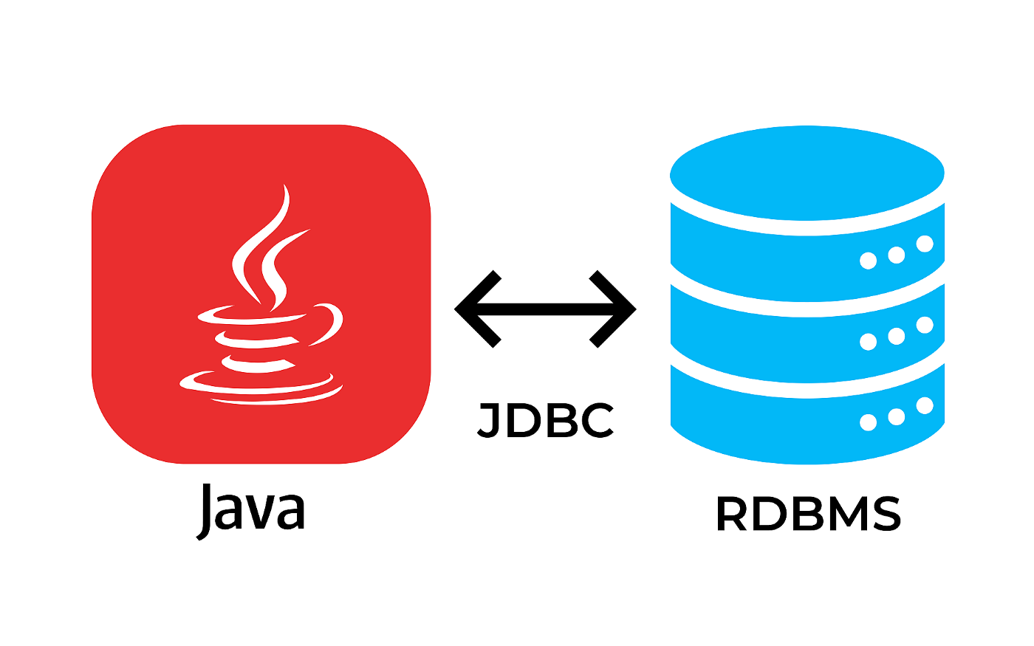
Introduction to JDBC

Slide 2
Agenda
What is JDBC?
JDBC Driver
Connection
Statement
ResultSet
Transaction

Slide 3
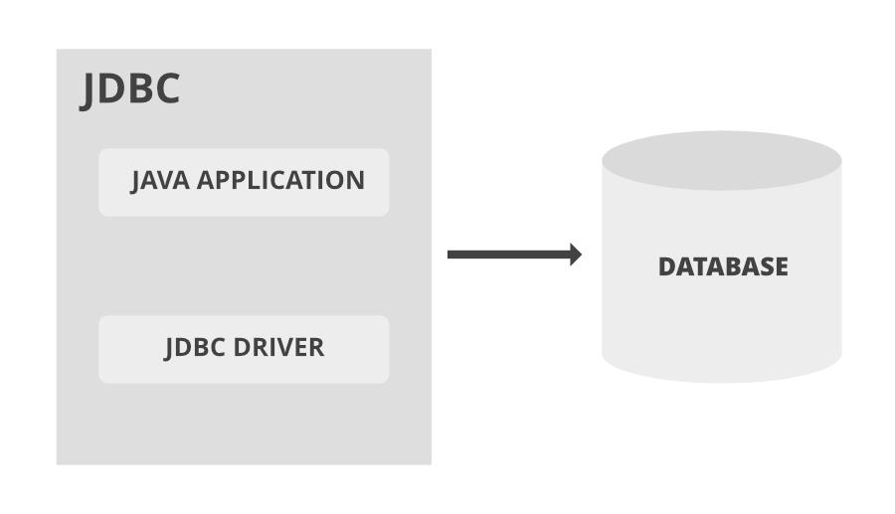
JDBC
What is JDBC?
JDBC is a Java API for executing SQL statement
Easy to send SQL statement to virtually any relational database
What does JDBC do?
Establish a connection with a database
Send SQL statement
Process the results

Slide 4
JDBC
Basic Example
import java.sql.*;
public class BasicJDBC {
public static void main(String[] args) {
try {
Class.forName("com.mysql.jdbc.Driver");
Connection con = DriverManager.getConnection("jdbc:mysql://127.0.0.1:3306/mydb",“user",“password");
Statement stm = con.createStatement();
ResultSet rs = stm.executeQuery("select journalname,amount from tjournal");
while(rs.next()) {
String name = rs.getString("journalname");
java.math.BigDecimal amt = rs.getBigDecimal("amount");
System.out.println(name+"="+amt);
}
} catch(Exception ex) {
ex.printStackTrace();
}
}
}

Slide 5
JDBC
JDBC Driver
JDBC-ODBC bridge driver
ODBC driver
Native API partly Java Driver
Native code to java
JDBC-Net pure Java driver
Network protocol
Native protocol pure Java driver
Thin drivers

Slide 6
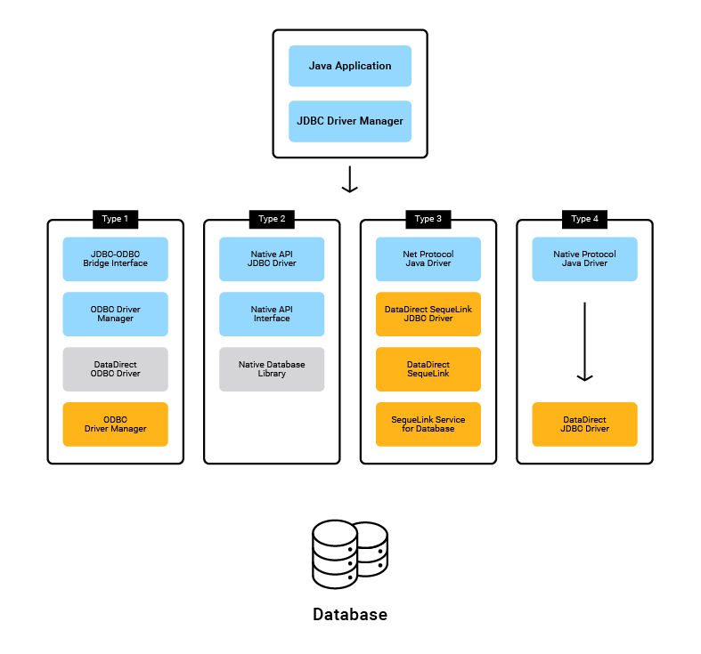
JDBC
JDBC Driver

Slide 7
JDBC
Connection
A Connection object represents a connection with a database
Opening a Connection
DriverManager.getConnection
URLs in General Use
jdbc:<subprotocol>:<subname>
String url = "jdbc:mysql://127.0.0.1:3306/mydb“;
Connection con = DriverManager.getConnection(url,“user",“password");

Slide 8
JDBC
DriverManager
The DriverManager class is the management layer of JDBC working between the user and the drivers
Loading the driver manager
Class.forName("com.mysql.jdbc.Driver");
Establishing a Connection
Class.forName("com.mysql.jdbc.Driver");
String url = "jdbc:mysql://127.0.0.1:3306/mydb“;
Connection con = DriverManager.getConnection(url,“user",“password");

Slide 9
JDBC
DBMS Driver & URL
DB | Driver | URL
MySQL | com.mysql.jdbc.Driver com.mysql.cj.jdbc.Driver | jdbc:mysql://host:port/dbname ex. jdbc:mysql://127.0.0.1:3306/mydb
SQLServer | com.microsoft.sqlserver.jdbc.SQLServerDriver | jdbc:sqlserver://host:port;DatabaseName=dbname ex. jdbc:sqlserver://127.0.0.1:1433;DatabaseName=mydb
Informix | com.informix.jdbc.IfxDriver | jdbc:informix-sqli://host:port/dbname:INFORMIXSERVER=online ex. jdbc:informix-sqli://127.0.0.1:9088/mydb:INFORMIXSERVER=ol_svr_custom
Oracle | oracle.jdbc.driver.OracleDriver | jdbc:oracle:thin:@host:port:dbname ex. jdbc:oracle:thin:@127.0.0.1:1521:mydb
DB2 | com.ibm.db2.jcc.DB2Driver | jdbc:db2://host:port/dbname ex. jdbc:db2://127.0.0.1:50000/mydb
PostgreSQL | org.postgresql.Driver | jdbc:postgresql://host:port/dbname ex. jdbc:postgresql://localhost:5432/mydb

Slide 10
JDBC
Statement
A Statement object is used to send SQL statement to a database
3 kind of statement : Statement, PreparedStatement and CallableStatement
Creating Statement Objects
Executing Statement Objects
String url = "jdbc:mysql://127.0.0.1:3306/mydb“;
Connection con = DriverManager.getConnection(url,“user",“password");
Statement stm = con.createStatement();
ResultSet rs = stm.executeQuery("select journalname,amount from tjournal");

Slide 11
JDBC
ResultSet
A ResultSet contains all of the rows which satisfied the conditions in an SQL statement and it provides access to the data in those rows
ResultSet rs = stm.executeQuery("select journalname,amount from tjournal");
while(rs.next()) {
String name = rs.getString("journalname");
java.math.BigDecimal amt = rs.getBigDecimal("amount");
System.out.println(name+"="+amt);
}

Slide 12
JDBC
ResultSet
Method | Description
public boolean next(): | is used to move the cursor to the one row next from the current position.
public boolean previous(): | is used to move the cursor to the one row previous from the current position.
public boolean first(): | is used to move the cursor to the first row in result set object.
public boolean last(): | is used to move the cursor to the last row in result set object.
public int getInt(int columnIndex): public int getInt(String columnName): | is used to return the data of specified column index / column name of the current row as int.
public String getString(int columnIndex): public String getString(String columnName): | is used to return the data of specified column index / column name of the current row as String.
public BigDecimal getBigDecimal(int columnIndex): public BigDecimal getBigDecimal(String columnName): | is used to return the data of specified column index / column name of the current row as java.math.BigDecimal.
public Date getDate(int columnIndex): public Date getDate(String columnName): | is used to return the data of specified column index / column name of the current row as java.sql.Date.
public Time getTime(int columnIndex): public Time getTime(String columnName): | is used to return the data of specified column index / column name of the current row as java.sql.Time.
public Timestamp getTimestamp(int columnIndex): public Timestamp getTimestamp(String columnName): | is used to return the data of specified column index / column name of the current row as java.sql.Timestamp.

Slide 13
JDBC
ResultSetMetaData
An object that can be used to get information about the types and properties of the columns in a ResultSet object
Method | Description
public int getColumnCount() throws SQLException | it returns the total number of columns in the ResultSet object.
public String getColumnName(int index) throws SQLException | it returns the column name of the specified column index.
public String getColumnTypeName(int index) throws SQLException | it returns the column type name for the specified index.
public String getTableName(int index) throws SQLException | it returns the table name for the specified column index.

Slide 14
JDBC
ResultSetMetaData
import java.sql.*;
public class BasicResultSetMetaData {
public static void main(String[] args) {
try {
Class.forName("com.mysql.jdbc.Driver");
Connection con = DriverManager.getConnection("jdbc:mysql://127.0.0.1:3306/mydb",“user",“password");
Statement stm = con.createStatement();
ResultSet rs = stm.executeQuery("select * from tjournal");
java.sql.ResultSetMetaData met = rs.getMetaData();
int colcount = met.getColumnCount();
while(rs.next()) {
for(int i=1;i<=colcount;i++) {
String name = met.getColumnName(i);
System.out.println(name+"="+rs.getString(name));
}
}
} catch(Exception ex) {
ex.printStackTrace();
}
}
}

Slide 15
JDBC
PreparedStatement
PreparedStatement interface inherits from Statement
Contain an SQL statement that has already been compiled
May have one or more parameters
A question mark (“?”) as a placeholder for each parameter

Slide 16
JDBC
PreparedStatement
import java.sql.*;
public class BasicPrepared {
public static void main(String[] args) {
try {
Class.forName("com.mysql.jdbc.Driver");
Connection con = DriverManager.getConnection("jdbc:mysql://127.0.0.1:3306/mydb",“user",“password");
String sql = "insert into tjournal(journalid,journalname,amount) values(?,?,?)";
PreparedStatement ps = con.prepareStatement(sql);
ps.setString(1,"3001");
ps.setString(2,"Fee");
ps.setBigDecimal(3,new java.math.BigDecimal(100));
int rows = ps.executeUpdate();
System.out.println("effected "+rows+" rows");
} catch(Exception ex) {
ex.printStackTrace();
}
}
}

Slide 17
JDBC
CallableStatement
A CallableStatement object provides a way to call stored procedures in a standard way for all DBMSs.
Stored Procedures are group of statements that compile in the database for some task

Slide 18
JDBC
CallableStatement
import java.sql.*;
public class BasicCallable {
public static void main(String[] args) {
try {
Class.forName("com.mysql.jdbc.Driver");
Connection con = DriverManager.getConnection("jdbc:mysql://127.0.0.1:3306/mydb",“user",“password");
String sql = "{call GetJournal(?)}";
CallableStatement cs = con.prepareCall(sql);
cs.setString(1,"1");
ResultSet rs = cs.executeQuery();
while(rs.next()) {
String id = rs.getString(1);
String name = rs.getString(2);
java.math.BigDecimal amt = rs.getBigDecimal(3);
System.out.println("id="+id+",name="+name+",amt="+amt);
}
} catch(Exception ex) {
ex.printStackTrace();
}
}
}

Slide 19
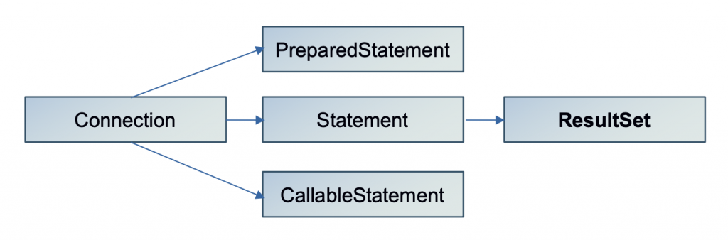
JDBC
JDBC Hierarchy

Slide 20
JDBC
Transaction
Transaction is a logical unit of work
Transaction support allows applications to ensure the following :
All the steps to complete a logical unit of work are followed
When one of the steps to the unit of work files fails, all the work done as part of that logical unit of work can be undone and the database can return to its previous state before the transaction began

Slide 21
JDBC
Transaction
The default behavior of a Connection is auto commit
public abstract void setAutoCommit(boolean) throws SQLException;
public abstract void commit() throws SQLException;
public abstract void rollback() throws SQLException;

Slide 22
JDBC
Transaction
connect to database
try {
set AutoCommit(false)
execute query1
execute query2
...
execute queryN
commit
} catch(Exception ex) {
rollback
}
close connection

Slide 23
JDBC
Transaction
import java.sql.*;
public class BasicTransaction {
public static void main(String[] args) {
try {
Class.forName("com.mysql.jdbc.Driver");
Connection con = DriverManager.getConnection("jdbc:mysql://127.0.0.1:3306/mydb",“user",“password");
try {
con.setAutoCommit(false);
String sql = "update tjournal set amount = ? where journalid = ?";
PreparedStatement ps = con.prepareStatement(sql);
ps.setBigDecimal(1,new java.math.BigDecimal(150));
ps.setString(2,"3001");
int rows = ps.executeUpdate();
System.out.println("effected "+rows+" rows");
con.commit();
} catch(SQLException ex) {
ex.printStackTrace();
con.rollback();
}
} catch(Exception ex) { ex.printStackTrace(); }
}
}

Slide 24
Reference
https://en.wikipedia.org/wiki/JDBC_driver
https://www.progress.com/faqs/datadirect-jdbc-faqs/what-are-the-types-of-jdbc-drivers
https://www.geeksforgeeks.org/jdbc-type-3-driver/
https://www.tutorialspoint.com/jdbc/jdbc-driver-types.htm
https://www.javatpoint.com/jdbc-driver
https://www.tutorialspoint.com/jdbc/jdbc-result-sets.htm
https://www.baeldung.com/java-transactions

Slide 25
Q & A

